Slide 1

CCA Meetup
Wednesday 12th May 2021
18:30 – 19:30

Slide 2
Agenda
Final update on Mayoral campaign
CEE Bill
Croydon Living Streets AGM
Feed our Future campaign
Croydon’s Great Big Green Week
Any other business

Slide 3
For Info

Slide 4
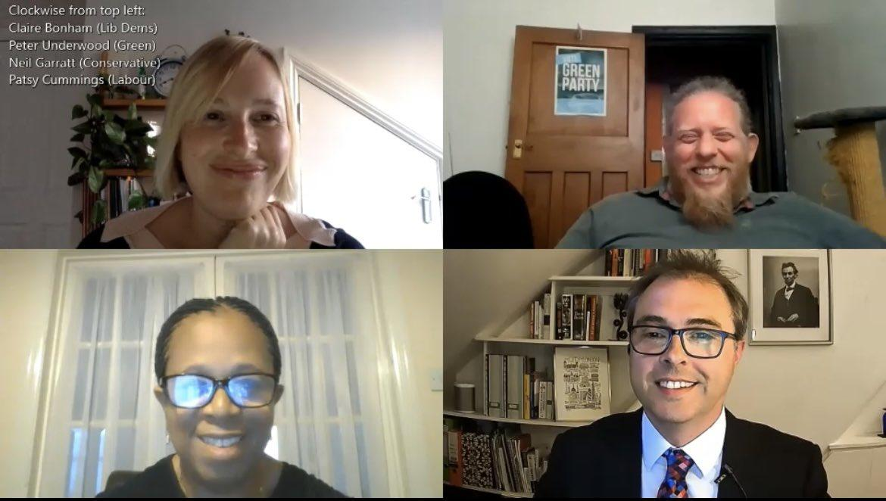
Final update on Mayoral Campaign
We did it!!
Thanks to everyone who came to the hustings event
Final results - Neil Garratt (Conservative) was elected for the London Assembly for the Croydon & Sutton seat
Hope to meet with him in the future to hold him to account - more on that later!
Notes:
Neil Garratt as ‘elected’ not chosen
Bullet 3 make it an action-e.g.set up a Time is Now advisory group

Slide 5

Climate & Ecological Emergency (CEE) Bill
The Bill asks the UK to take responsibility for its fair share of greenhouse gas emissions, to actively restore biodiverse habitats in the UK and to stop damage to the environment through the production, transportation and disposal of the goods we consume.
Tabled by Caroline Lucas of the Green Party, the Bill now has support of over 100 MPs across 8 political parties, from England, Scotland, Wales and Northern Ireland.
Phase 2 of the campaign is beginning soon, and CCA are already a supporting organisation.
You can register to support as an individual here: https://www.ceebill.uk/sign-up
Notes:
Are you explaining the campaign and how to get involved? What are the cross party environmental ctteess?

Slide 6

Croydon Living Streets Annual General Meeting
Joined by:
  Emma Griffin, speaking about the TfL funded Footways project, which has been curated to connect interesting places via calm and accessible streets
  Sarah Stone, author of the 'Crikey It's Croydon' account celebrating Croydon's green spaces and the pleasure of exploring them on foot.
Following the Q & A, they will set out the aims for the following year to focus on developing as a local group.
Time: May 13, 2021 08:00 PM London
Join Zoom Meeting: https://us02web.zoom.us/j/83570327439
Meeting ID: 835 7032 7439

Slide 7
Get Involved!

Slide 8

Feed Our Future Campaign
Getting more plant-based options in our schools would help the climate, children’s health and save the council money!
Next step is to meet with the School Food & Physical Activity Officer at Croydon Council before launching our petition
Who would like to come to the meeting?

Slide 9
How might we hold politicians to account?
Objectives
Baseline information
Possible actions
People to target
Ways to monitor progress
Ways to publicise

Slide 10

The Climate Coalition: Great Big Green Week
The Climate Coalition is the UK’s largest group of people dedicated to action against climate change, comprising over 100 organisations and over 22 million members!
They run an annual national campaign called “Great Big Green Week”
  It will take place 18 – 26 September 2021, and will be the largest event for climate and nature ever seen in the UK.
  Thousands of events will celebrate how communities are taking action to tackle climate change and protect green spaces, and encourage others to get involved too.
Notes:
Link to https://greatbiggreenweek.com/about/ explain national climate coalition BGW first before you go into local actions etc

Slide 11
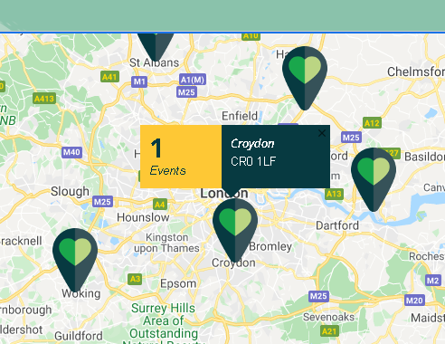
Croydon’s Great Big Green Week!
It’s going to take a lot of planning, so we can’t do it alone!
We’re going to ask if other local environmental groups want to collaborate and host events that week too
Our ask:
  Would anyone like to organise any events?
  Do you have any connections that might
want to host an event/get involved?

Slide 12
Any other business?

Slide 13
Next meetup:
Wednesday 9th June
18:30 - 19:30
We will finally set up the WhatsApp group too! Please let us know if you want to be in it

